Slide 1
Generalization of Construction for Reinhardt Polygons
Jiahui Liu
Columbia University
2014.08.06

Slide 2
Introduction
A look back at construction of 2-prime sporadic Reinhardt polygons
Generalization from 2-prime to 3-prime case

Slide 3
2-prime Reinhardt Polygon Construction
Let n = pqr, p and q distinct odd primes, r ≥ 2.
Construct nontrivial f1(z) and f2(z) so:
• F(z) = f1(z)Φq(−zpr) + f2(z)Φp(−zqr). • F(0) = 1, deg(F) < n, leading coefficient 1, and nonzero coefficients alternate ±1.
Then F(z) corresponds to a Reinhardt polygon.
Verify it is sporadic.

Slide 4
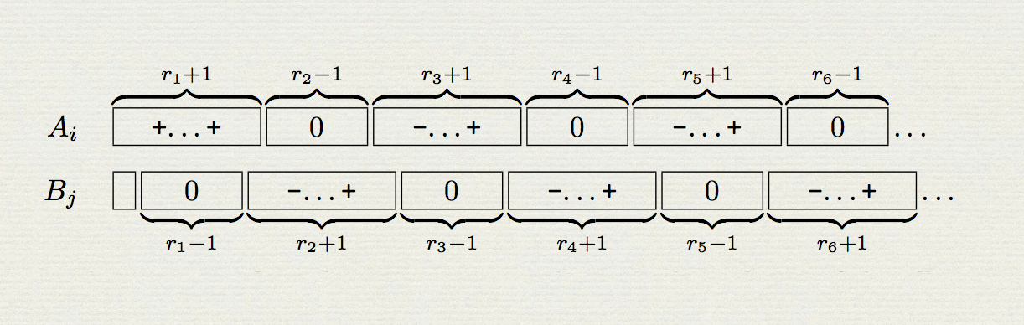
Form f1(z) from A1, ..., Ap; f2(z) from B1, ..., Bq, each size r.
• Choose a composition of r into an even number of parts, (r1,r2,…rm).

Slide 5

Use the composition to guide selections of the
Blocks:
We describe the construction of the sub-blocks Ai,j. Choose a fixed value for s from {−1, 1}. Then select

Slide 6
For a nonnegative integer k and b ∈ {1,−1}, let So(k,b) denote the set of se- quences of length k over {−1,0,1} having an odd number of nonzero terms, the first of which is b, and which alternate in sign.
Se(k, b) denote the set of sequences of length k over {−1, 0, 1} with an even number (possibly zero) of nonzero terms, the first of which is b (if there is a nonzero term) and alternating in sign.

Slide 7
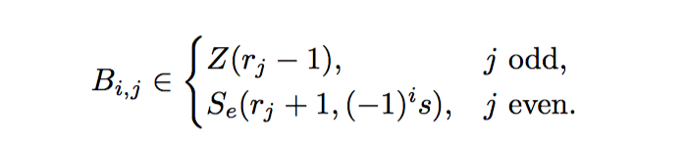
The polynomial f2(z) is also constructed relative to the composition c of r. In this case, we describe q blocks B1, ..., Bq, each with size r. In the same way, each block Bi is composed of 2m sub-blocks, denoted Bi,j with 1 ≤ j ≤ 2m, and in this case we select:
Then we construct the sequence of coefficients for f2(z) by shifting the terms in the aggregated blocks by one position to the right, with the last element negated and then moved to the first position. If R denotes this shift-right-and-negate operator, then the coefficients of f2(z) are given in sequence by R(B1B2 ...Bq).

Slide 8
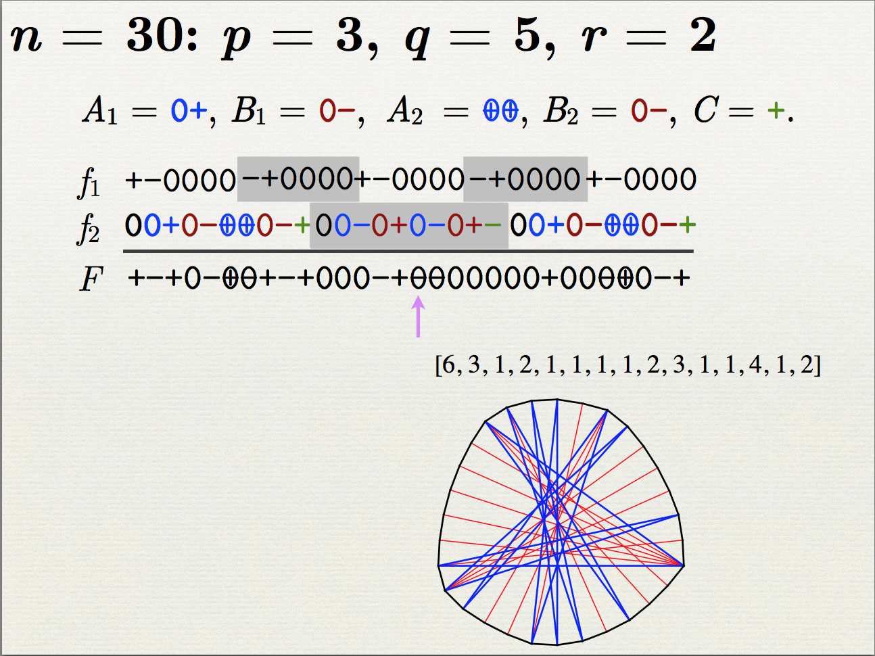

Slide 9
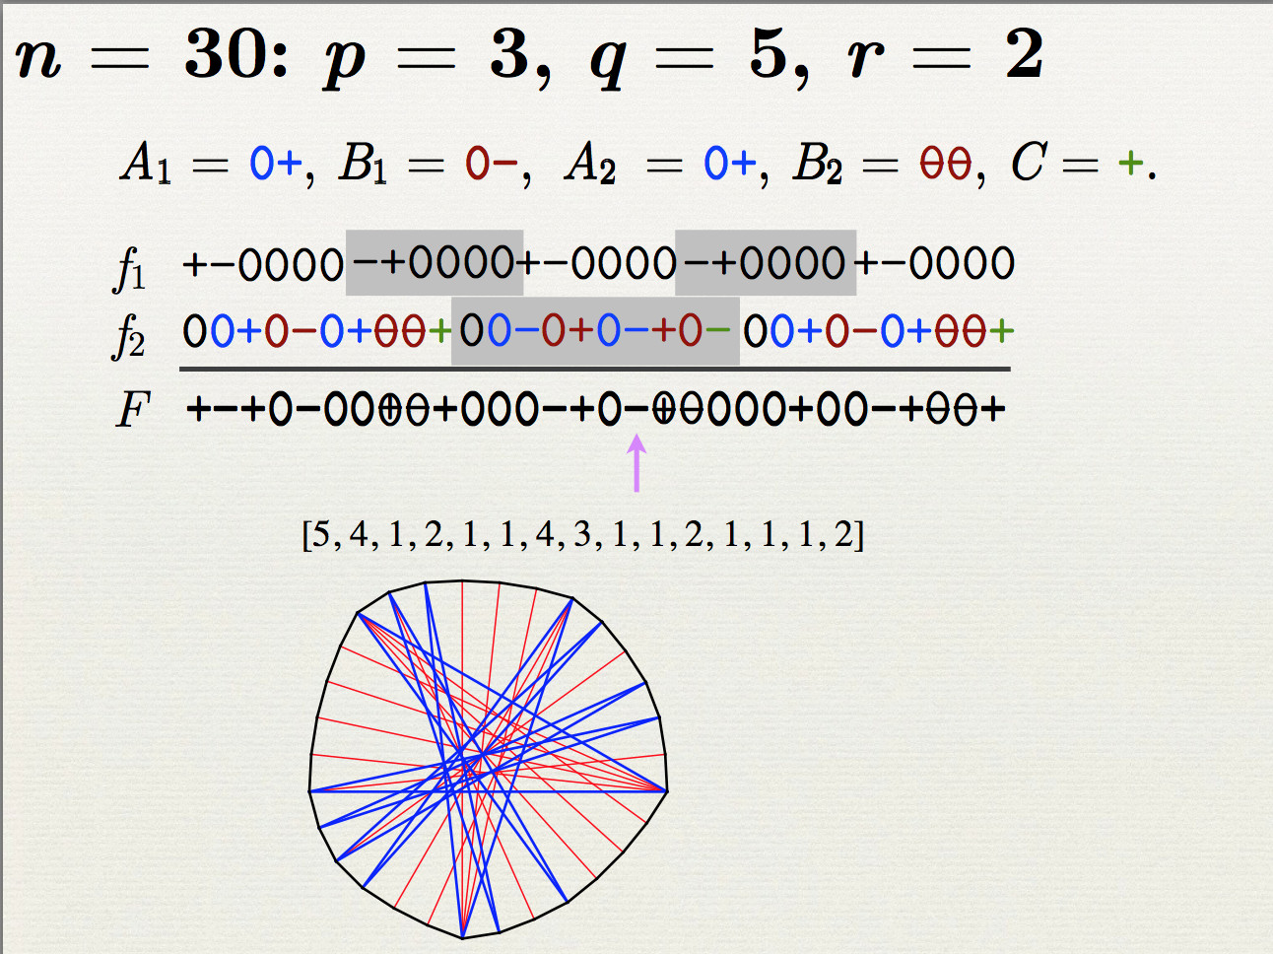

Slide 10
Sporadic Polygons
• Construction produces a sporadic polygon, unless A1 =⋯=At =C0=−B1 =⋯=−Bt.
• Sporadic polygons constructed: 2q(r−1)−1 − 2r−2.
• Even more: 2p − 2 choices for f1(z).

